Slide 1
Chatbot Datasets
In His Name, the Most High

Slide 2
Large Datasets
Reddit (3.7 billion)
OpenSubtitles (400+ million)
Ubuntu Dialogue Corpus (26+ million)
Amazon QA (3.6 million)
Customer Support on Twitter (3+ million)
Few-NERD
And many more …

Slide 3
Medium Datasets
Cornell Movie Dialogs Corpus
Friends Corpus
Santa Barbara Corpus of Spoken American English
The NPS Chat Corpus
ConvAI2 (chit-chat dataset)
IRC Chat Logs
Supreme Court Dialogs Corpus
Wikipedia QA
And many more …

Slide 4
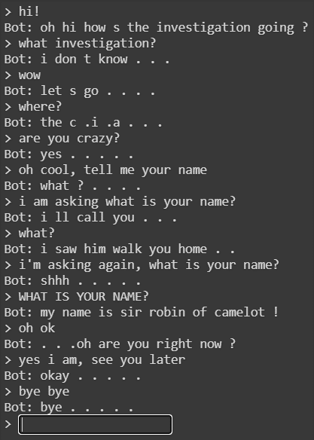
Bot trained with Cornell Movie Dialogs Corpus

Slide 5
Small Datasets (Intent Detection and Slot Filling)
ATIS (Air Travel Information System)
SNIPS
Chitchat/small-talk dataset (Github – Kaggle – RASA templates – Chatito - …)
NLU-Evaluation-Corpora (Ask Ubuntu Corpus - …)
CoNLL 2003
Intent Classification and Out-of-Scope Prediction
COVID-19 QA
Subset of Larger datasets
And many more …

Slide 6
Comparison and Final thoughts
ATIS (Air Travel Information System): atis_flight - atis_flight_time - atis_airfare - …
Small-talk (gathering from github & …)
SNIPS: GetWeather - BookRestaurant - PlayMusic – AddToPlaylist - …
Augmenting
COVID-19 (COVID-Q and …)
Intent Detection? Entity recognition? Joint?
More research or others?

Slide 7
Pre-processing
choice overload!
Converting to lower case and tokenization and Removing punctuation
Removing misspellings and stop words
Lemmatization / stemming
Imbalanced classes distribution (SMOTE – ADASYN – augmentation - …)
And …

Slide 8
Thanks.

